Slide 1
Restoration & Segmentation of Digitized Image
Ankit Kumar Yogi 141178
Ankit Shukla 141179
Ankita Mishra 141180

Slide 2
Digital Image Processing
Digital image processing is the use of computer algorithms to perform image processing on digital images .
Image processing is a method to perform some operations on an image, in order to get an enhanced image or to extract some useful information from it.

Slide 3
Purpose of Image processing
The purpose of image processing is divided into 5 groups. They are:
Visualization - Observe the objects that are not visible.
Image sharpening and restoration - To create a better image.
Image retrieval - Seek for the image of interest.
Measurement of pattern – Measures various objects in an image.
Image Recognition – Distinguish the objects in an image.

Slide 4
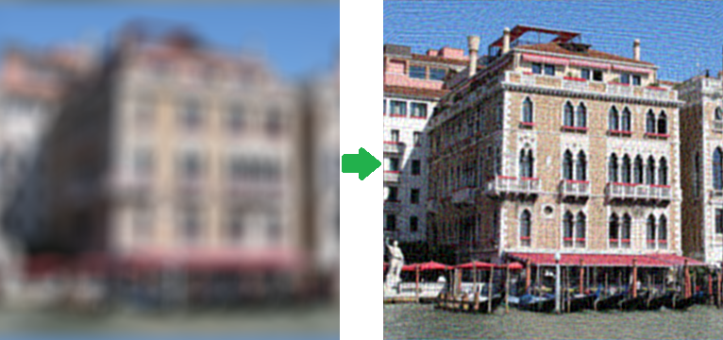
Image Restoration
Image Restoration is the operation of taking a corrupt/noisy image and estimating the clean, original image.
Corruption may come in many forms such as motion blur, noise and camera mis-focus.
Before Image Restoration
After Image Restoration

Slide 5
Image Degradation and Noise Cause
The degradations may be due to
Sensor noise
Blur due to camera misfocus
Relative object-camera motion
Random atmospheric turbulence
Types of image noise are
Gaussian Noise
Rayleigh Noise
Erlang(Gamma) Noise
Exponential Noise and many more..

Slide 6
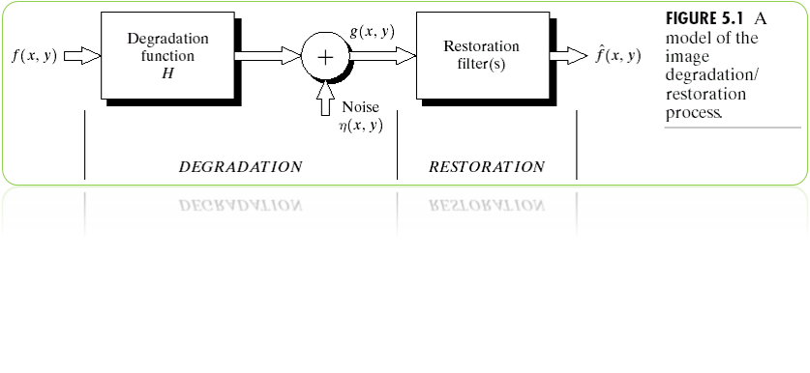
Image Restoration – Degradation Model
The degradation process for an image uses a degradation function together with an additive noise term.
This operates on an input image f(x, y) to produce a degraded image g(x, y) Given g(x, y), some knowledge of the degradation function H, some knowledge about the additive noise term η(x, y) the objective of restoration is to obtain an estimate fˆ(x, y) will be to f(x, y).

Slide 7
Spatial and Frequency domain Representation
Spatial domain: additive noise
The degraded image in Spatial domain is
where h(x,y) is a system that causes image distortion and h(x,y) is noise.
Frequency domain : blurring
The degraded image in Frequency domain is
Where the terms in capital letters are Fourier transforms.

Slide 8
Image restoration technique
Inverse Filter In this method we look at an image assuming a known blurring function. We will see that restoration is good when noise is not present and not so good when it is.
Weiner Filtering In this section we implement image restoration using wiener filtering, which provides us with the optimal trade-off between de-noising and inverse filtering. We will see that the result is in general better than with straight inverse filtering.
Wavelet Restoration We implement three wavelet bassed algorithms to restore the image.
Blind Deconvolution In this method, we assume nothing about the image. We do not have any information about the blurring function or on the additive noise. We will see that restoring an image when we know nothing about it is very hard.

Slide 9
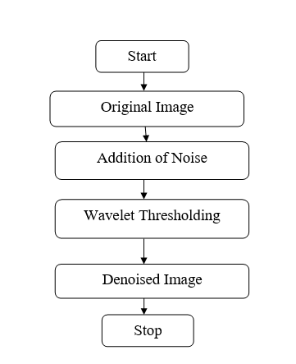
Fig : Flowchart of the image restoration process

Slide 10
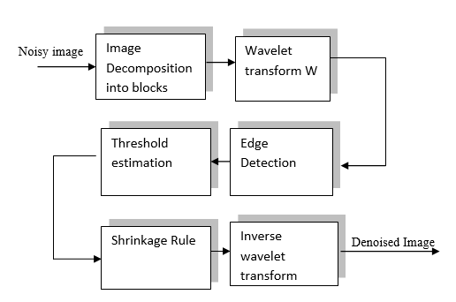
Fig : Diagram of proposed denoising method

Slide 11
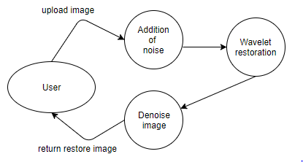
Fig : Dataflow diagram for image restoration

Slide 12
Image restoration algorithm
Input: Degraded-image
Output: Restored-image
Procedure:
Step1: Read the image g and perform the digitization.
Step2: Convert the image into matrix of m x n such that each pixel value represents a matrix element A_{mn.}
Step3: Perform the Wavelet transform W on image G = W(g)
the discrete wavelet transform decomposes the input image into different frequency
subbands, labeled as LL_{j}, LH_{k}, HL_{k} and HH_{k}, k =1, 2, …, J
Step4: Apply the edge detection on G

Slide 13
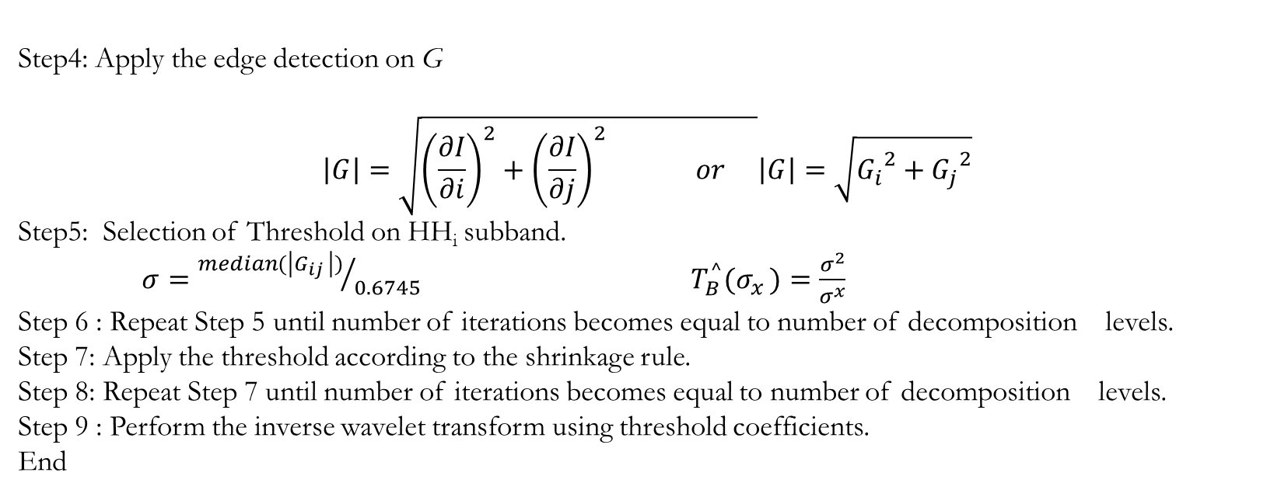
Step4: Apply the edge detection on G
$$\left|G\right|=\sqrt{{\left(\frac{∂I}{∂i}\right)}^{2}+{\left(\frac{∂I}{∂j}\right)}^{2} or }\left|G\right|=\sqrt{{G_{i}}^{2}+{G_{j}}^{2}}$$
Step5: Selection of Threshold on HH­_{i} subband.
$σ={median(\left|G_{ij }\right|)}/{0.6745}$ $T_{B}^{^}(σ_{x })=\frac{σ^{2}}{σ^{x}}$
Step 6 : Repeat Step 5 until number of iterations becomes equal to number of decomposition levels.
Step 7: Apply the threshold according to the shrinkage rule.
Step 8: Repeat Step 7 until number of iterations becomes equal to number of decomposition levels.
Step 9 : Perform the inverse wavelet transform using threshold coefficients.
End

Slide 14
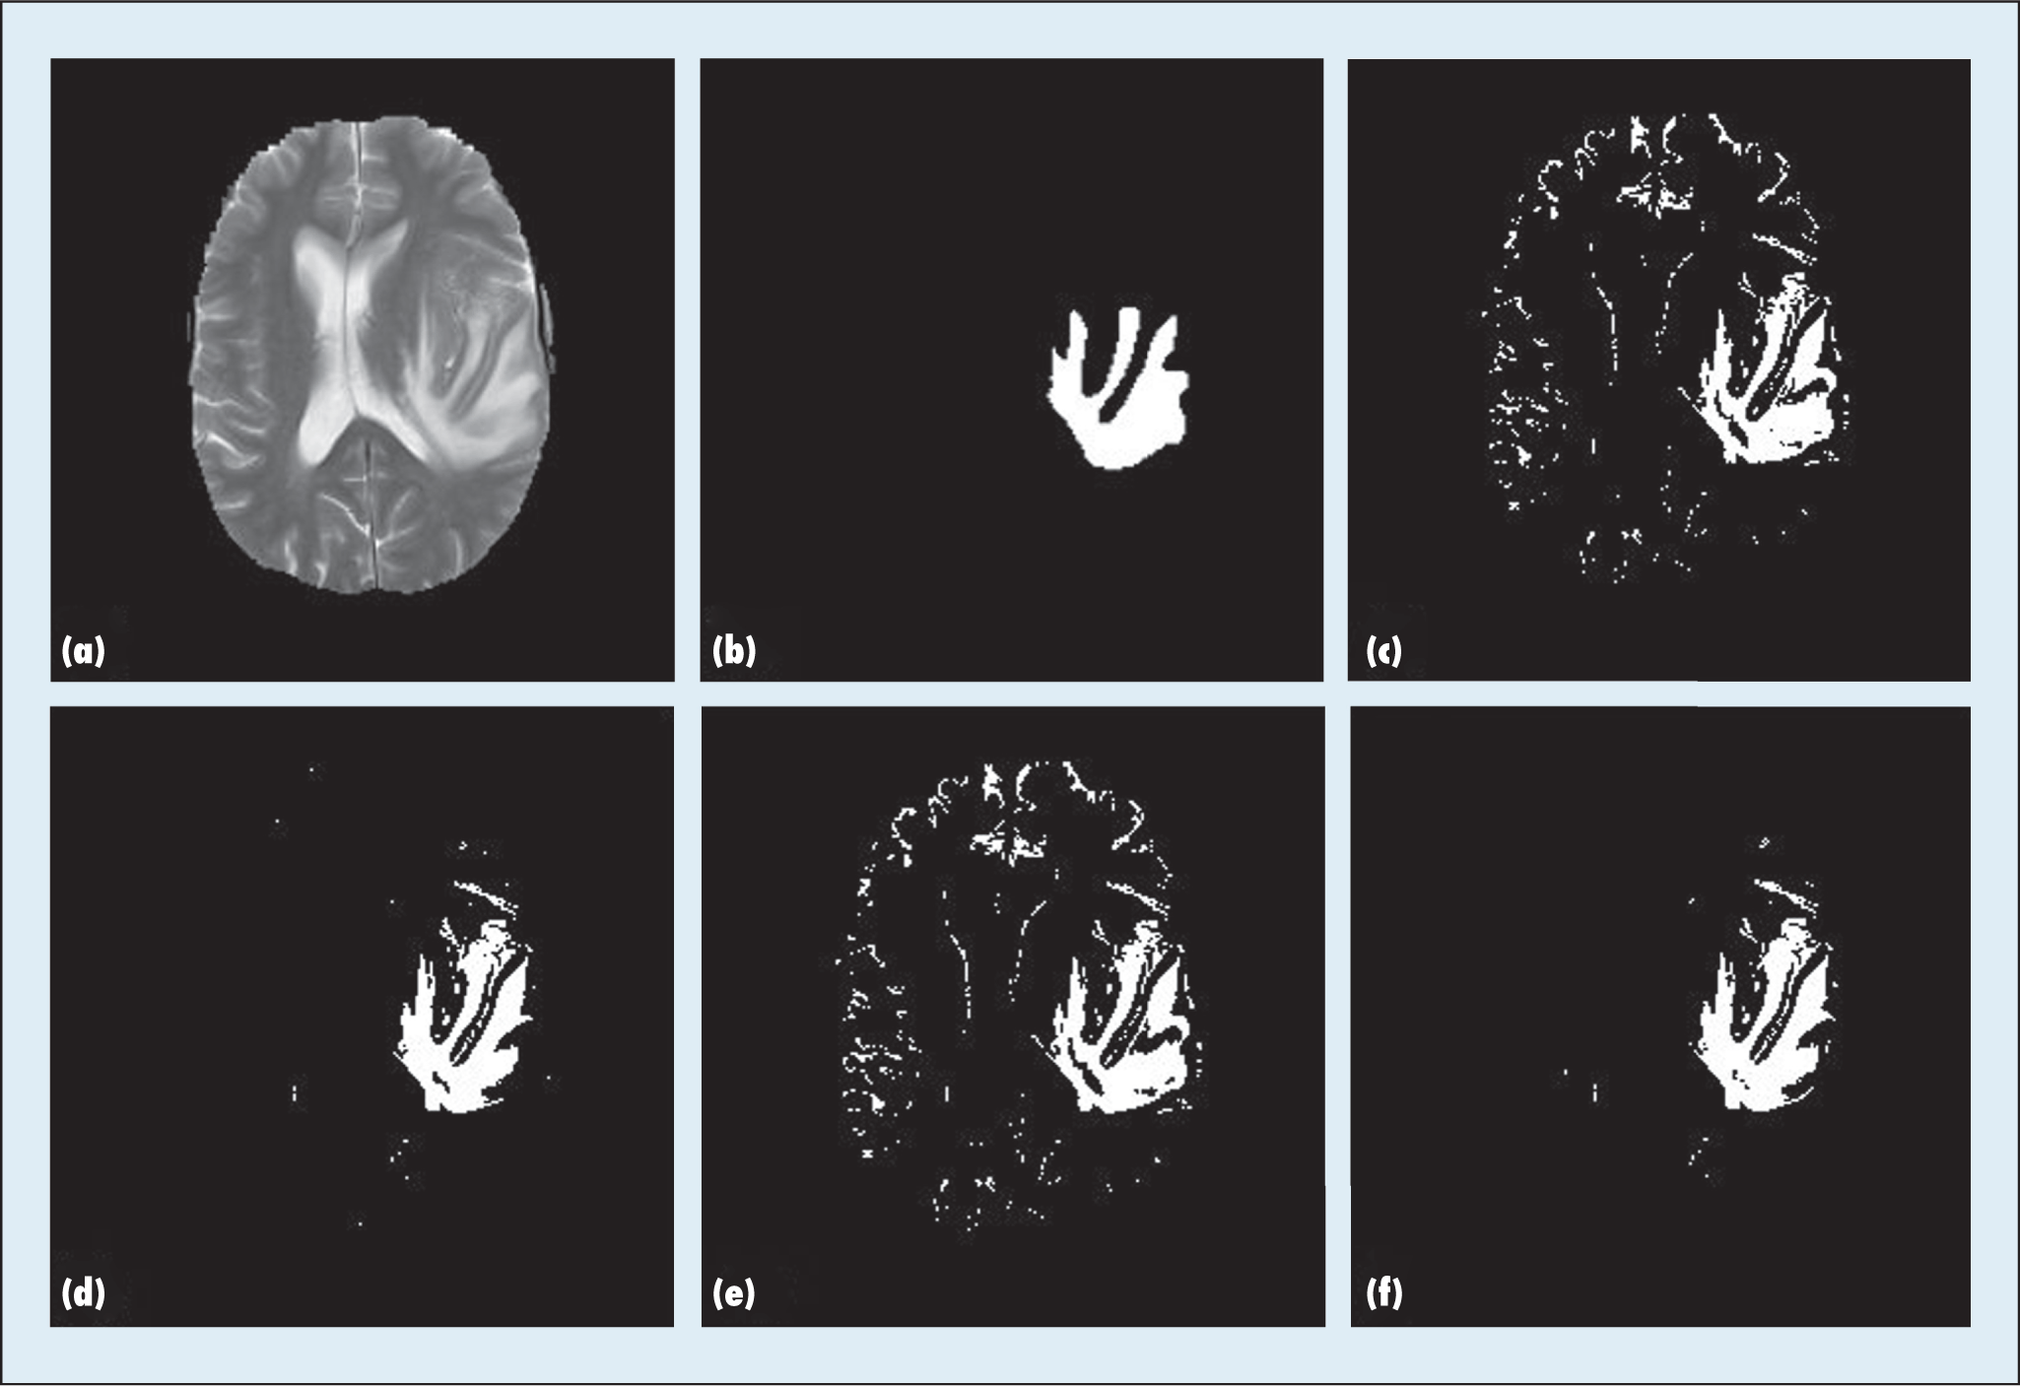
Image segmentation
Image segmentation is the process of partitioning a digital image into multiple segments (sets of pixels, also known as super-pixels).
The goal of segmentation is to simplify and/or change the representation of an image into something that is more meaningful and easier to analyze.
Brain MRI
Segmented image

Slide 15
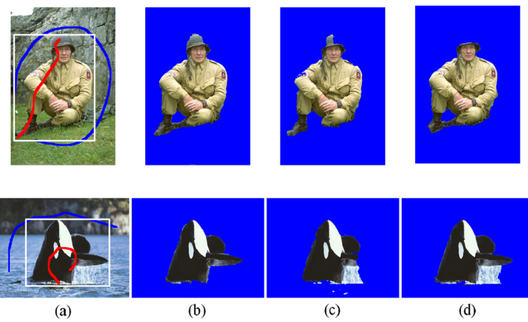
(a) Input images have a red, blue, and white scribble. Pixels under the red and blue scribble correspond to training data for the foreground and background region respectively, and they are equally used for the proposed method and conventional modified method of Boykov and Jolly (2001) with GMM. Also, the white rectangle is the interface for Grabcut method. (b) the results of proposed method, (c) conventional modified method, (d) Grabcut method. (For interpretation of the references in colour in this figure legend.

Slide 16
Image segmentation method
Region based segmentation
Watershed segmentation
Edge detection
Application of image segmentation are :
Content-based image retrieval
Machine vision
Pedestrian detection
Face detection and many more ..

Slide 17
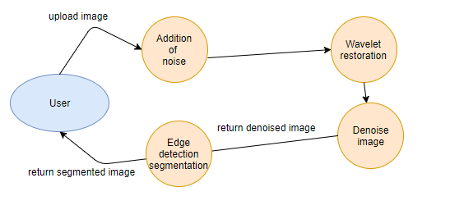
Fig : Dataflow diagram for image restoration and segmentation

Slide 18
Automation of image processing using machine learning
Method for automation are
Adaboost classifier
Grabcut segmentation method

Slide 19


